Slide 1
of Qna
MENU
ANALYSIS
CONTACT
NETWORK OF QNA
network
Course : Data Science Lab – I
Instructor : Dr. Dootika Vats

Slide 2

Do we do you have any
MENU
ANALYSIS
CONTACT
NETWORK OF QNA
What
when
Question

Slide 3
Google
MENU
ANALYSIS
CONTACT
NETWORK OF QNA
|| Quora || Stack exchange ||
|| Stack Overflow ||

Slide 4
What we have done In this project
Data scraping
Data cleaning
01
02
R Shiny app
answers to some questions
03
04
MENU
ANALYSIS
CONTACT
NETWORK OF QNA
Scrap the data from Quora, Stack exchange and Stack overflow
Data cleaning in R for removing unwanted data
Shiny app for proper visualizations and features
Some questions which can be answered by this app

Slide 5
some library we have used
Tidyverse
R vest
String r
shiny
ggplot2
plotly
MENU
ANALYSIS
CONTACT
NETWORK OF QNA
An opinionated collection R packages design for Data Science.
Help you Scrap data from the webpages.
It is used for tie, bind or hang other objects.
It provides an elegant and powerful web framework for building web application in R.
It provides a helpful command to create complex plot from a data frame.
For creating interactive web-based graphs.

Slide 6
topic we have scrap question on
MENU
ANALYSIS
CONTACT
NETWORK OF QNA
Technology
Movie
Health
Food
Science
Music
Visiting and Travel
Sports
Python
C++
Java
Fortran
MATLAB
Statistics
Politics
Sports

Slide 7
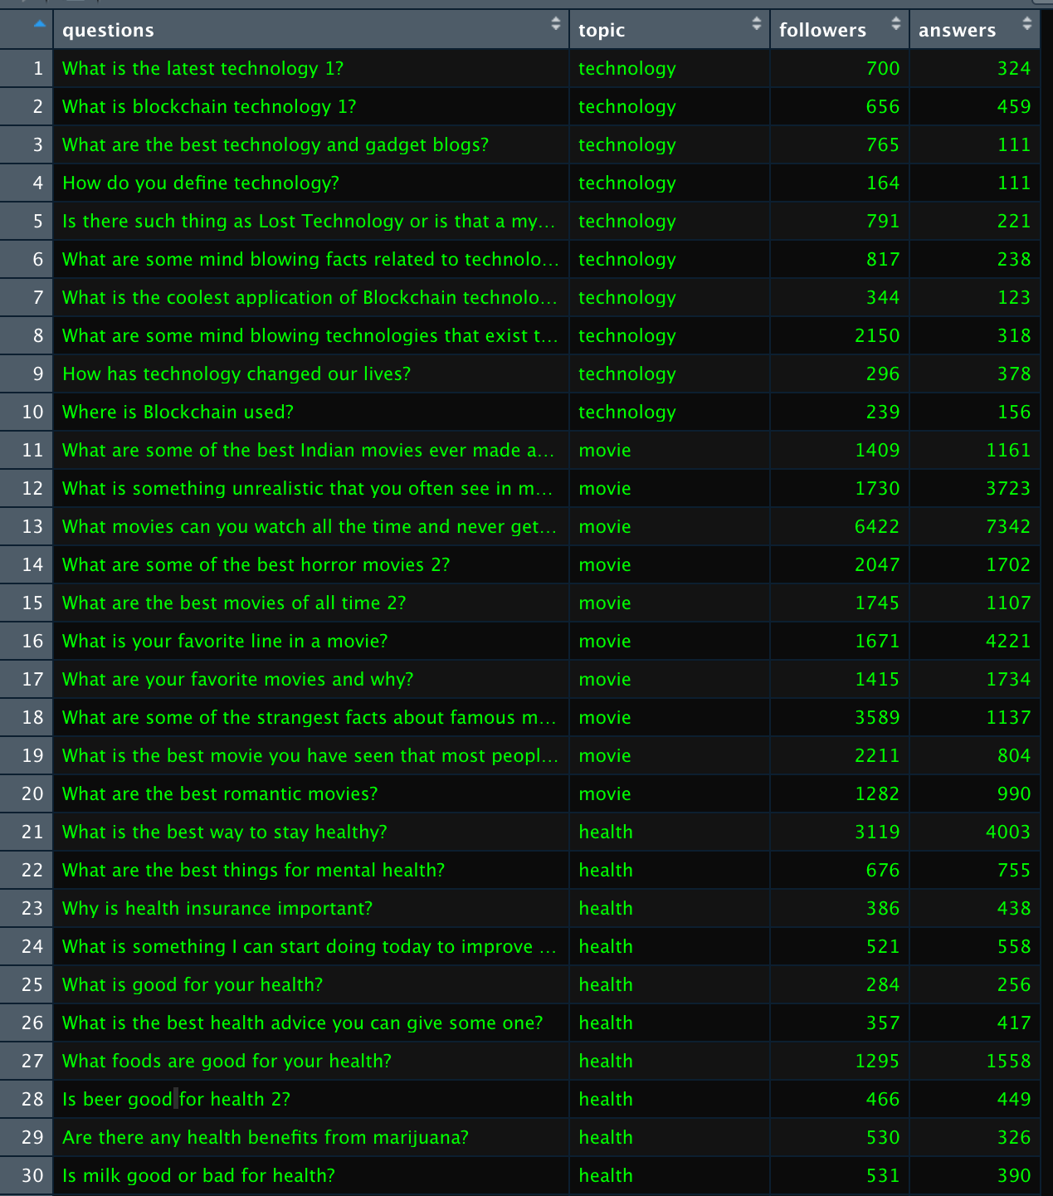
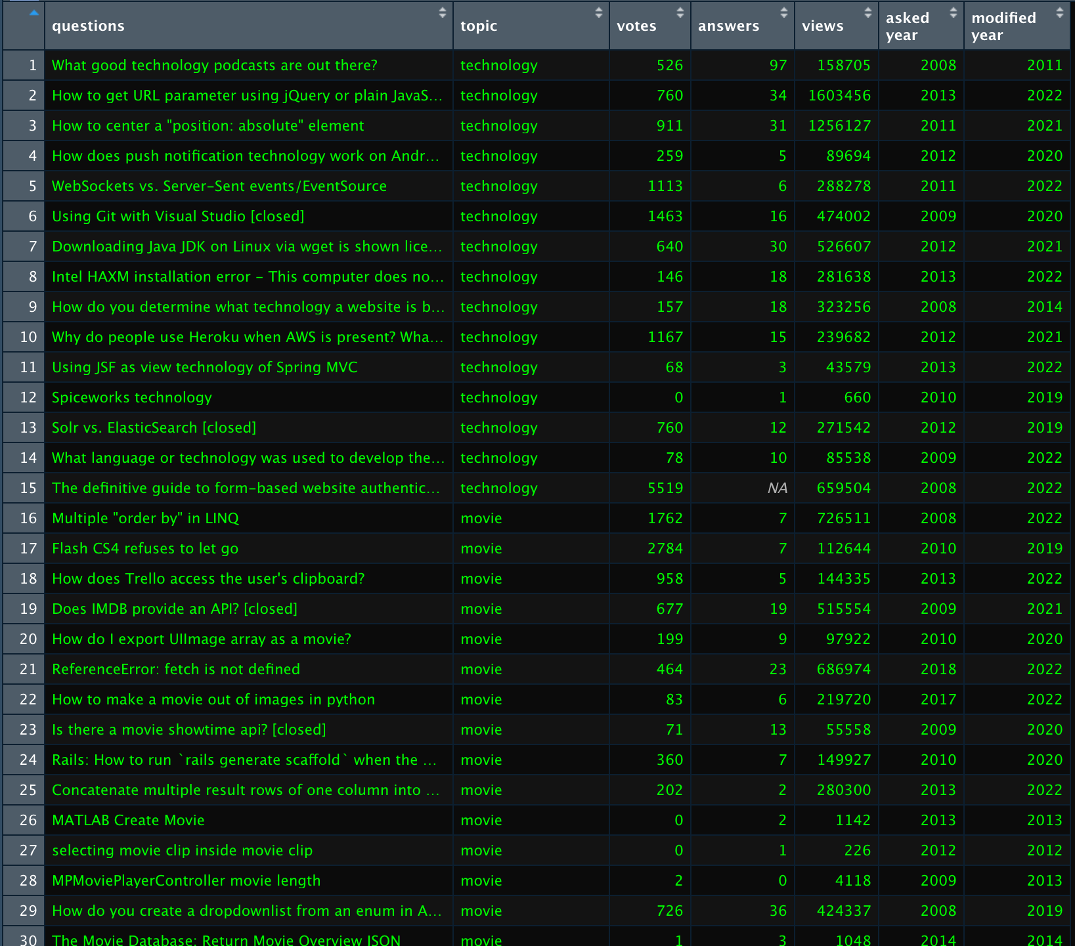
MENU
ANALYSIS
CONTACT
NETWORK OF QNA

Slide 8
Some questions we have answered
Which topic has more number of followers ?
Is there any relation between followers and answers ?
Which topic is more popular ?
Where you should ask a question ?
MENU
ANALYSIS
CONTACT
NETWORK OF QNA

Slide 9
shiny app
MENU
ANALYSIS
CONTACT
NETWORK OF QNA
r

Slide 10
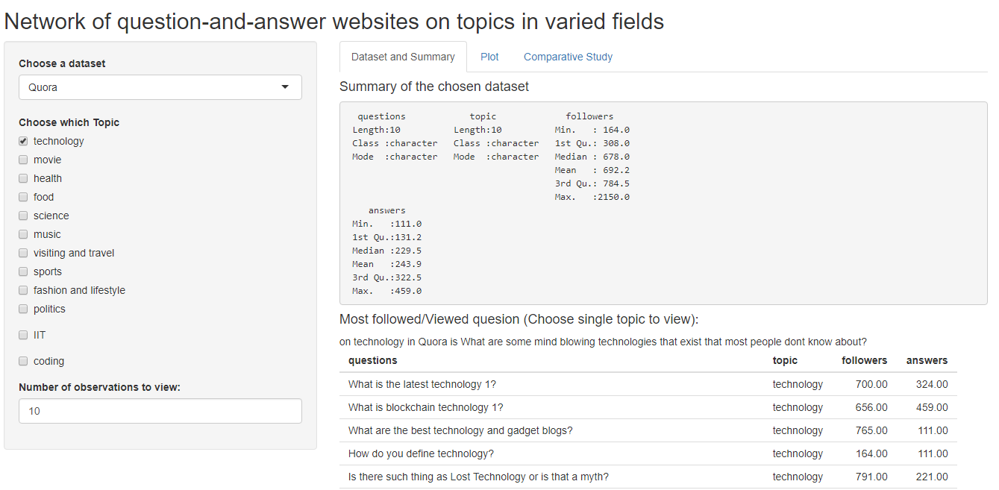
MENU
ANALYSIS
CONTACT
NETWORK OF QNA

Slide 11
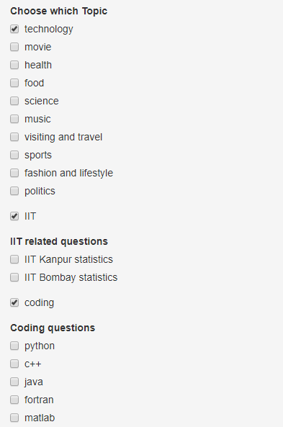
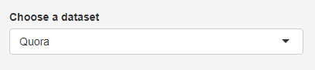
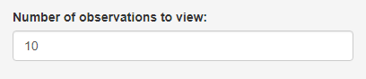
MENU
ANALYSIS
CONTACT
NETWORK OF QNA

Slide 12
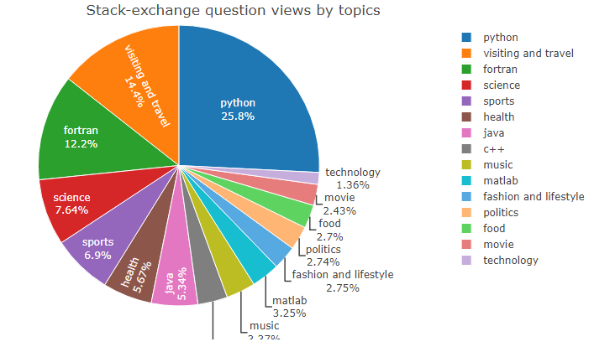
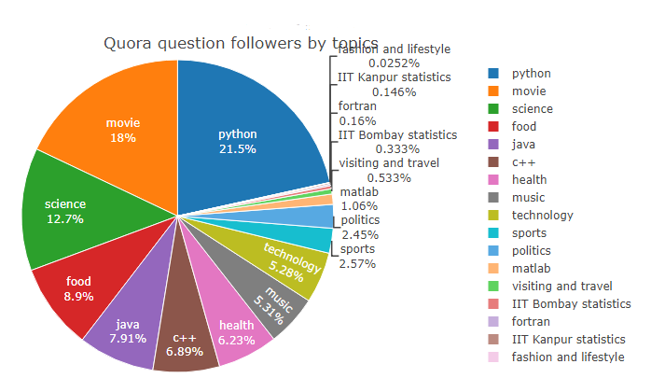
MENU
ANALYSIS
CONTACT
NETWORK OF QNA

Slide 13
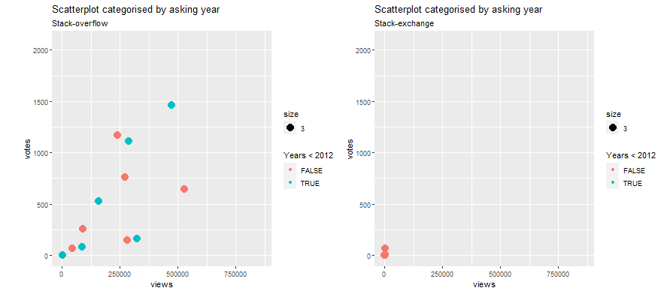
MENU
ANALYSIS
CONTACT
NETWORK OF QNA

Slide 14
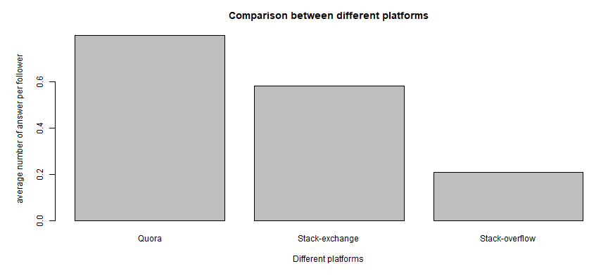
MENU
ANALYSIS
CONTACT
NETWORK OF QNA

Slide 15
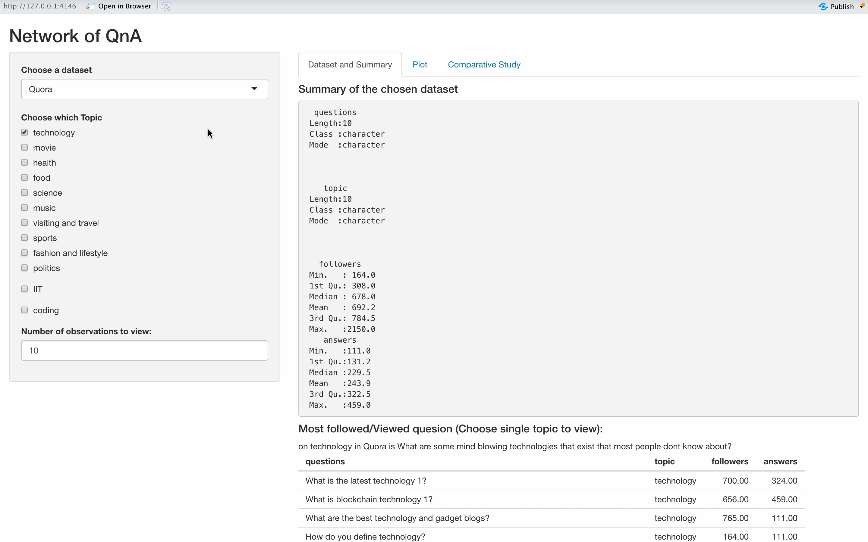
MENU
ANALYSIS
CONTACT
NETWORK OF QNA

Slide 16
CONTACT
MENU
ANALYSIS
CONTACT
NETWORK OF QNA
Satmeet Singh
200809
satmeets20@iitk.ac.in
VALA YASH
Dasari Charithambika
210302
cdasari21@iitk.ac.in
Vala Yash
211142
valayashv21@iitk.ac.in

Slide 17
MENU
ANALYSIS
CONTACT
NETWORK OF QNA
THANK YOU
For giving you time

